Slide 1
CSE 260 Logic Gates

Slide 2
Binary Logic
Binary logic consists of binary variables and logical operations.
Variables are designated by letters such as A, B, C, x, y, z etc. with only 2 possible values: 1 and 0.
Logic operations: and, or, not etc.

Slide 3
Logic Gates
The most basic digital devices are called gates.
A gate has one or more inputs and produces an output that is a function of the current input values.
The relationship between the input and the output is based on a certain logic.

Slide 4
All Logic Gates
NOT
AND
OR
XOR
XNOR
NAND
NOR

Slide 5

Truth Table
Provides a listing of every possible combination of inputs and its corresponding outputs.

Slide 6
Most Important logic gates
AND
OR
NOT

Slide 7
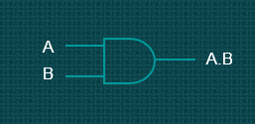

2-input AND gate
1 = on
0 = off
Output will be 1 only when both inputs are 1

Slide 8

2-input OR gate
A
B
A+B
1 = on
0 = off
Output will be 1 when at least one input is 1

Slide 9

NOT gate (Inverter)
A
A'
A
A'
1 = on
0 = off
Output will be the inverse of the input

Slide 10
Some Other Gates
NAND
NOR
XOR
XNOR

Slide 11


2-input XOR gate
1 = on
0 = off
Output will be 1 only when both inputs are different

Slide 12

2-input XNOR gate
A
B
A ʘ B
1 = on
0 = off
Output will be 1 only when both inputs are same
Inverse of XOR

Slide 13
Universal gates
A universal gate is a gate which can implement any other gate
NAND & NOR

Slide 14


2-input NAND gate
1 = on
0 = off
Inverse of AND

Slide 15


2-input NOR gate
1 = on
0 = off
Inverse of OR

Slide 16

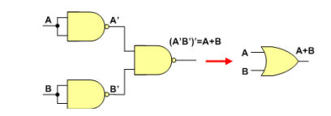

Using NAND
NOT Gate
OR Gate
AND Gate

Slide 17


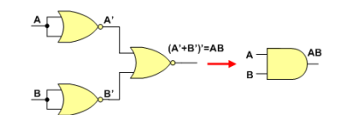
Using NOR
NOT Gate
OR Gate
AND Gate

Slide 18
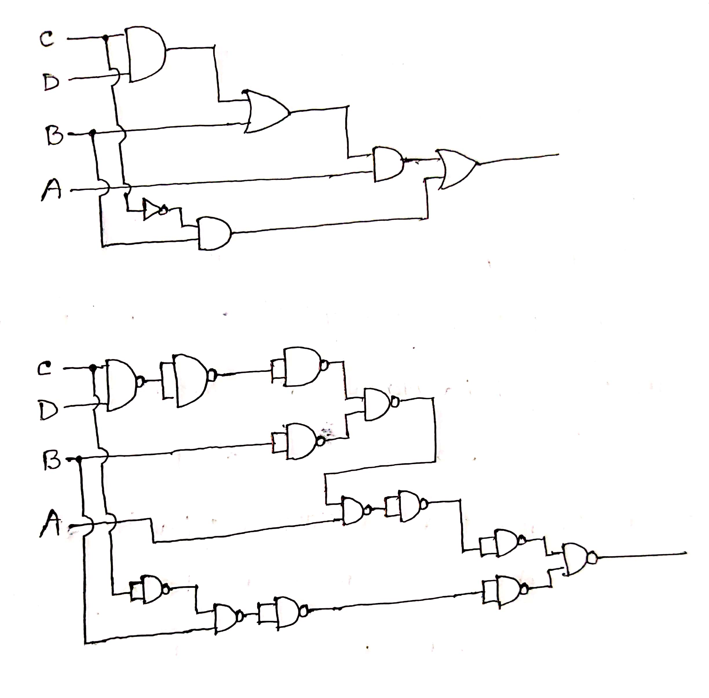
Use NAND to represent F=A(B+CD)+BC’
If an expression is given, represent it using AND,OR and NOT gates
Draw each gate with equivalent NAND or NOR representation
Remove any 2 cascading inverters
Remove inverters from single input connection and replace input with its complement.
https://www.youtube.com/watch?v=-EjGrPhol70&list=PLTlXQu_162Qg8-oRqv_iGYHSz2XrfUc51&index=7

Slide 19
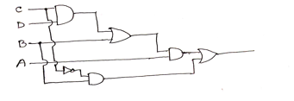
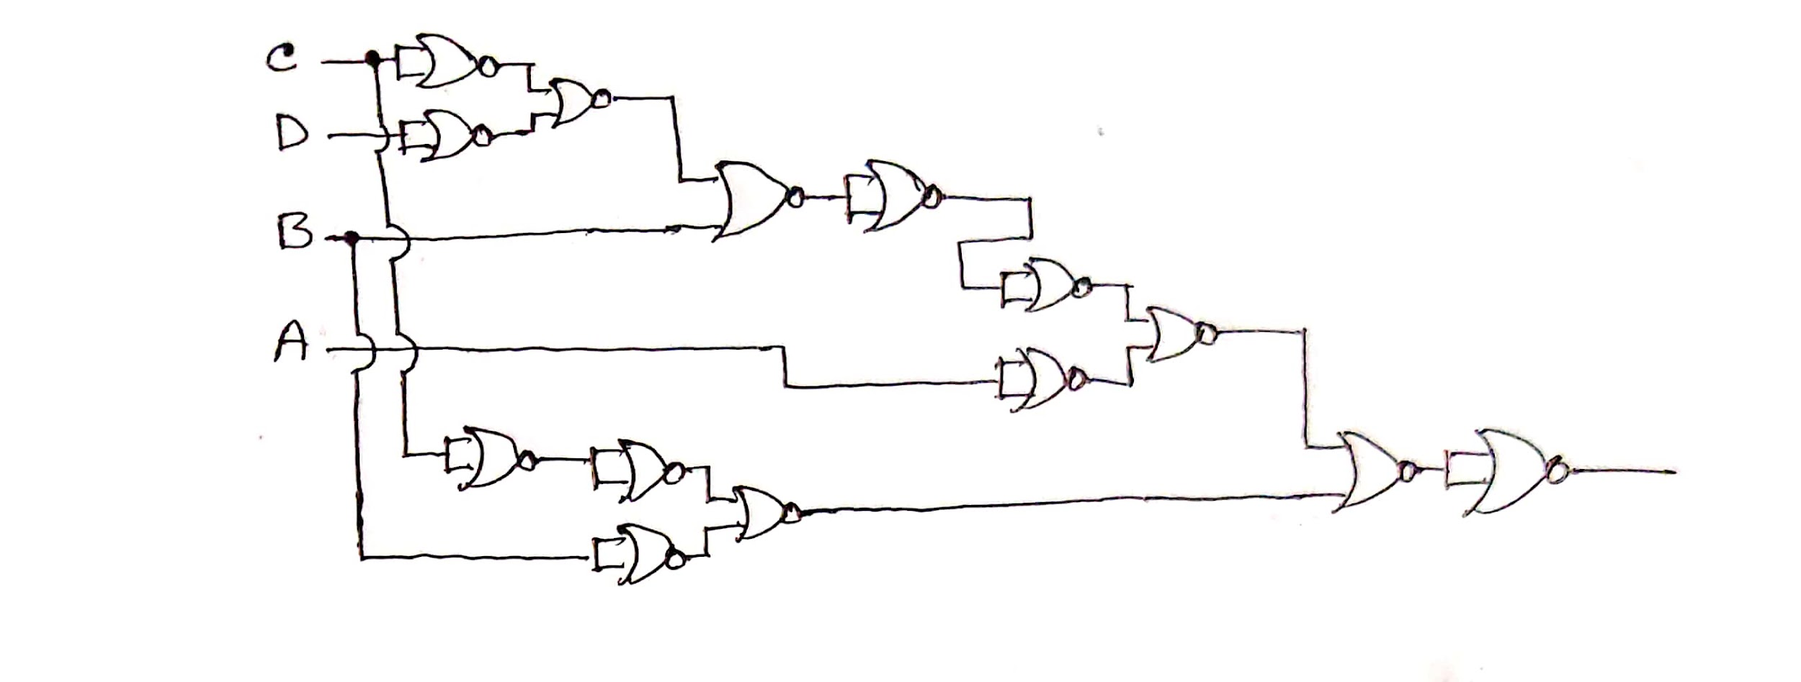
Use NOR to represent F=A(B+CD)+BC’
If an expression is given, represent it using AND,OR and NOT gates
Draw each gate with equivalent NAND or NOR representation
Remove any 2 cascading inverters
Remove inverters from single input connection and replace input with its complement.
https://www.youtube.com/watch?v=eAuOqgT5lqM&list=PLTlXQu_162Qg8-oRqv_iGYHSz2XrfUc51&index=8

Slide 20
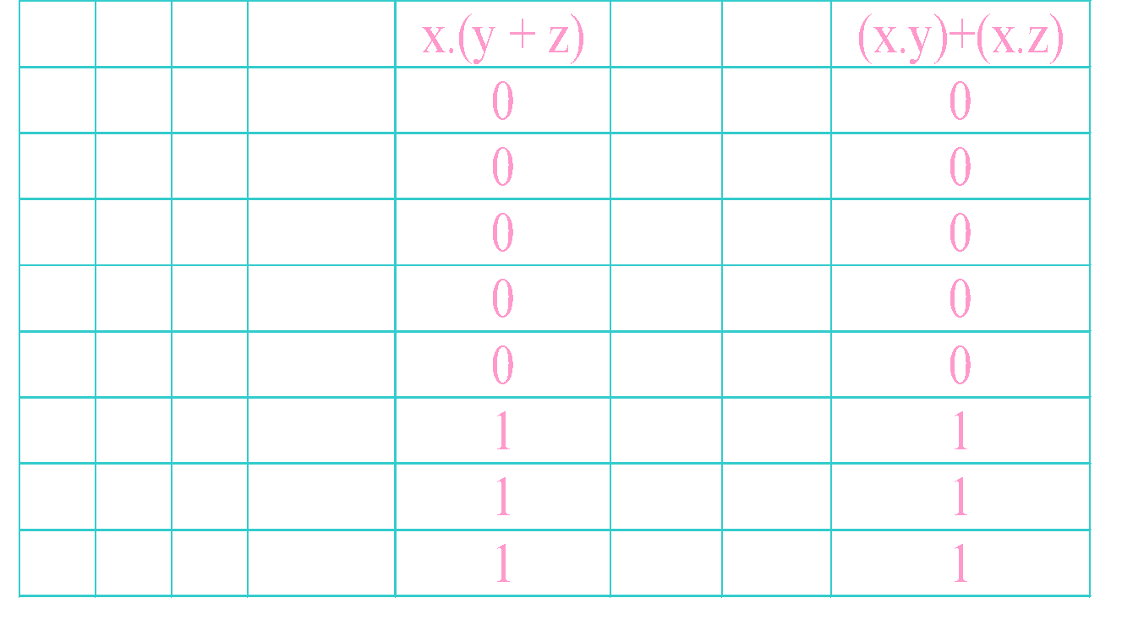
Proof using Truth Table
Prove that: x . (y + z) = (x . y) + (x . z)
(i) Construct truth table for LHS & RHS of above equality.
(ii) Check that LHS = RHS
Postulate is SATISFIED because output column 5 & 8 (for LHS & RHS expressions) are equal for all cases.
Note: if there are 3 variable, truth table should have 2^{n} combination of input

Slide 21
BOOLEAN ALGEBRA

Slide 22
Boolean Algebra
Like any other deductive mathematical system, defined with a set of elements, a set of operators and a number of axioms or postulates.
In Boolean algebra, set consists at least 2 variables say x & y, with 2 binary operations {+} and {.} and 1 unary operation {‘}

Slide 23
Boolean algebra Postulates
Closure: For every x, y in B [let, B is the set],
x + y is in B
x . y is in B
Commutative laws: For every x, y in B,
x + y = y + x
x . y = y . x
Complement: For every x in B, there exists an element x' in B such that
x + x' = 1
x . x' = 0

Slide 24
Boolean algebra Postulates
Associative laws: For every x, y, z in B,
(x + y) + z = x + (y + z) = x + y + z
(x . y) . z = x .( y . z ) = x . y . z
Identities (0 and 1):
0 + x = x + 0 = x for every x in B
1 . x = x . 1 = x for every x in B
Distributive laws: For every x, y, z in B,
x . (y + z) = (x . y) + (x . z)
x + (y . z) = (x + y) . (x + z)

Slide 25
Duality
Duality Principle – every valid Boolean expression (equality) remains valid if the operators and identity elements are interchanged, as follows:
+ ↔ .
1 ↔ 0
Example: Given the expression
a + (b.c) = (a+b).(a+c)
then its dual expression is
a . (b+c) = (a.b) + (a.c)

Slide 26
Duality
Duality gives free theorems – “two for the price of one”. You prove one theorem and the other comes for free!
If (x+y+z)' = x'.y.'z' is valid, then its dual is also valid:
(x.y.z)' = x'+y'+z’
If x + 1 = 1 is valid, then its dual is also valid:
x . 0 = 0

Slide 27
Basic Theorems of Boolean Algebra
identity
Postulate 5 (a) x+0=x (b) x.1=x
Postulate 3 (a) x+x’=1 (b) x.x’=0
Th 1 (a) x+x=x (b) x.x=x
Th 2 (a) x+1=1 (b) x.0=0
Th 3, involution (x’)’=x
Pos 2 (a) x+y=y+x (b) xy=yx
Th 4 (a) x(yz)=(xy)z (b)x+(y+z)=(x+y)+z
Pos 6 (a) x(y+z)=xy+xz (b) x+yz=(x+y)(x+z)
Th 5, DeMorgan (a) (x+y)’=x’y’ (b) (xy)’=x’+y’
Th 6, Absorption (a) x+xy=x (b) x(x+y)=x
complement
commutative
Distributi--ve
All are very very important!

Slide 28
Basic Theorems of Boolean Algebra
Theorems can be proved using the truth table method. (Exercise: Prove De-Morgan’s theorem using the truth table.)
They can also be proved by algebraic manipulation using axioms/postulates or other basic theorems.

Slide 29
Theorem 2a can be proved by:
x + 1= x+(x+x’) (complement)
= (x+x)+x’ (Th. 4)
= x+x’ (complement)
= 1
By duality, theorem 2b:
x.(0)= 0
Note: There can be other ways of making this proof. See Morris Mano

Slide 30
Basic Theorems of Boolean Algebra
Theorem 6a (absorption) can be proved by:
x + x.y = x.1 + x.y (identity)
= x.(1 + y) (distributivity)
= x.(y + 1) (commutativity)
= x.1 (Theorem 2a)
= x (identity)
By duality, theorem 6b:
x.(x+y) = x
Try prove this by algebraic manipulation.

Slide 31
Operator Precedence
Parenthesis
NOT
AND
OR
Highest
Lowest

Slide 32
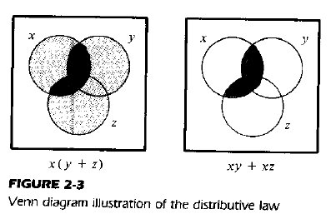
Ven Diagram
ven diagram for boolean algebra

Slide 33

Boolean Functions (Solve ?)
Examples:
F1= xyz'
F2= x + y'z
F3=(x'y'z)+(x'yz)+(xy')
F4=xy'+x'z
From the truth table, F3=F4.
Can you also prove by algebraic manipulation that F3=F4?

Slide 34
F3=(x'y'z)+(x'yz)+(xy')
= x’y’z+x’yz+xy’
=x’z(y’+y)+xy’
=x’z(1)+xy’
=x’z+xy’
=F4

Slide 35
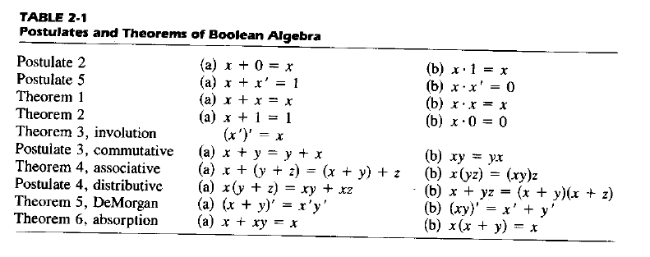
Try it yourself
a)Simplify to minimum literals: xy+xy’
b)Reduce to 4 literals(variables) : BC+AC’+AB+BCD

Slide 36
Solution
A) xy+xy’=x(y+y’)=x(1)=x
B)BC+AC’+AB+BCD
=BC(1+D)+AC’+AB
=BC(1)+AC’+AB
=BC+AB+AC’
=B(C+A)+AC’

Slide 37
Try it yourself: simplify the following equations
1. x+x’y
2. x(x’+y)
3. x’y’z+x’yz+xy’

Slide 38
Solution
1. x+x’y=(x+x’).(x+y)=1.(x+y)=x+y
2. x(x’+y)=xx’+xy=0+xy=xy
3. x’y’z+x’yz+xy’ = x’z(y’+y)+xy’=x’z+xy’
Now Try Proving Using Truth Table!!!

Slide 39
Complementing a function
Take dual of the function
Complement each literals
Example: F1= x’yz’+x’y’z
Dual of the function F1 is (x’+y+z’)(x’+y’+z)
Complement each literal= (x+y’+z)(x+y+z’)
Therefore, F1’= (x+y’+z)(x+y+z’)
Same as applying De-Morgan’s law on the function

Slide 40
Try it yourself
What is the complement of
F2=x(y’z’+yz)

Slide 41
Solution
F2’= (x(y’z’+yz))’
Duality: x+(y’+z’)(y+z)
Complement= x’+(y’+z’)(y+z)
Therefore F2’ =x’+(y+z)(y’+z’)

Slide 42
More Practice:
Simplify the following Boolean expression to a minimum number literals:
a) xy + xy′
b) (x + y)(x + y′)
c) xyz + x′y + xyz′
d) (A+B)′(A′+B′)′

Slide 43
Solution
a) xy + xy′ = x ( y+y′)= x.1 = x
b) (x+y)(x+y′) = xx + xy′ + yx+yy′ = x + xy′ + xy + 0 = x (1+ y′ + y) = x.1= x
Also (x+y)(x+y′) =x+ yy′ = x + 0 = x
c) xyz + x′y + xyz′ = xy(z+z′) + x′y = xy +x′y = y(x+x′)=y
d) (A+B)′(A′+B′)′= (A′B′).(AB) = 0
Notes:
‹#›

Slide 44
Practice! Practice! Practice!
Find the complement of the following expressions:
a) xy′+x′y
b) (AB′+C)D′+E
c) (x+y′+z)(x′+z′)(x+y)

Slide 45
Solution
a) [xy′+x′y]′ = (xy′)′ . (x′y)′ = (x′+y).(x+y′) = xx′ + yy′ + xy+x’y’=xy+x’y’
b) [(AB′+C)D′+E]′ = [(AB′+C)D′]′.E′ = [(AB′+C)′+D] . E′= [(A′+B).C′ +D].E′ =
= (A′+B+D).(C′+D).E′
c) [(x+y′+z)(x′+z′)(x+y)]′ = (x+y′+z)′+(x′+z′)′+(x+y)′= x′yz′ + xz + x′y′

